Slide 1
MAT 271 PROJECT
Christine wanjiku
21-2130

Slide 2
LINK TO GITHUB
https://github.com/Christine22042003/housing-pricing-prediction.git
https://github.com/Christine22042003/housing-pricing-prediction.git

Slide 3
INTRODUCTION
This project is about House Prices Prediction.
House prices vary from house to house, this is because of various features such as the number of bedrooms, the no of bathrooms, the location, square footage and etc. So inorder to make an informed decision we need to look at those features that gives the buyer and the seller an average amount of money the house may cost.
My goal for this project is to use regression techniques in order to estimate the price of a house.

Slide 4
PROBLEM STATEMENT
There are a lot of houses distributed by the developer especially in the rural areas but most of the houses are abandoned since the ignorance of people to measure the quality of the house and thus leads to an oversupply of homes in the wrong location.
Developers need to overlook many factors that are affecting the prices of houses such as the facilities provided near the place before purchasing a new house.

Slide 5
SIGNIFICANCE AND LIMITATIONS
SIGNIFICANCE
Helps people who plan to buy a house hence makes them to have an informative decision making.
Reduces economic spending.
LIMITATIONS
Data gained maybe biased.

Slide 6
DATA EXPLORATION
My dataset is from kaggle.
My dataset contains house prices and its various features from California 1990 census.
The dataset has 20640 rows and 10 columns.

Slide 7
DATA PREPROCESSING
Data preprocessing includes the following steps; data cleaning, feature selection and engineering, data splitting.
DATA CLEANING
This step involves identifying and handling missing values, duplicate data, and outliers in the dataset.
From the data I had to do a lot of cleaning since in the ocean proximity it was in word form and we can only its proximity to the ocean in numeric form.
So I divided the ocean proximity into four parts these are one hour near the ocean, inland, island, near bay and near ocean.
FEATURE ENGINEERING
This step involves selecting relevant features from the dataset and creating new features that may improve the performance of the model.

Slide 8
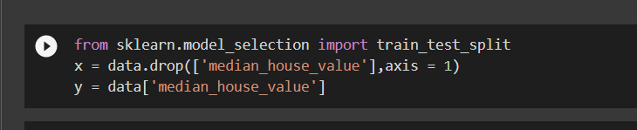
DATA SPLITTING
This step involves splitting the data into training and testing sets to evaluate the performance of the model.
In this process we are going to define the ‘X’ variable (independent variable) and the ‘Y’ variable (dependent variable). After defining the variables, we will use them to split the data into a train set and test set. Splitting the data can be done using the ‘train_test_split’ function provided by scikit-learn in python.

Slide 9
DATA VISUALIZATION
Data visualization is the graphical representation of information and data. By using visual elements like charts, graphs, and maps, data visualization tools provide an accessible way to see and understand trends, outliers, and patterns in data.
I made a heatmap, which is used to determine which columns of data have a high correlation to the sale price of the houses.
In the heat we can see that I use blue, green and yellow. The blue represents strong correlation compared to the yellow representation which have a negative correlation.

Slide 10
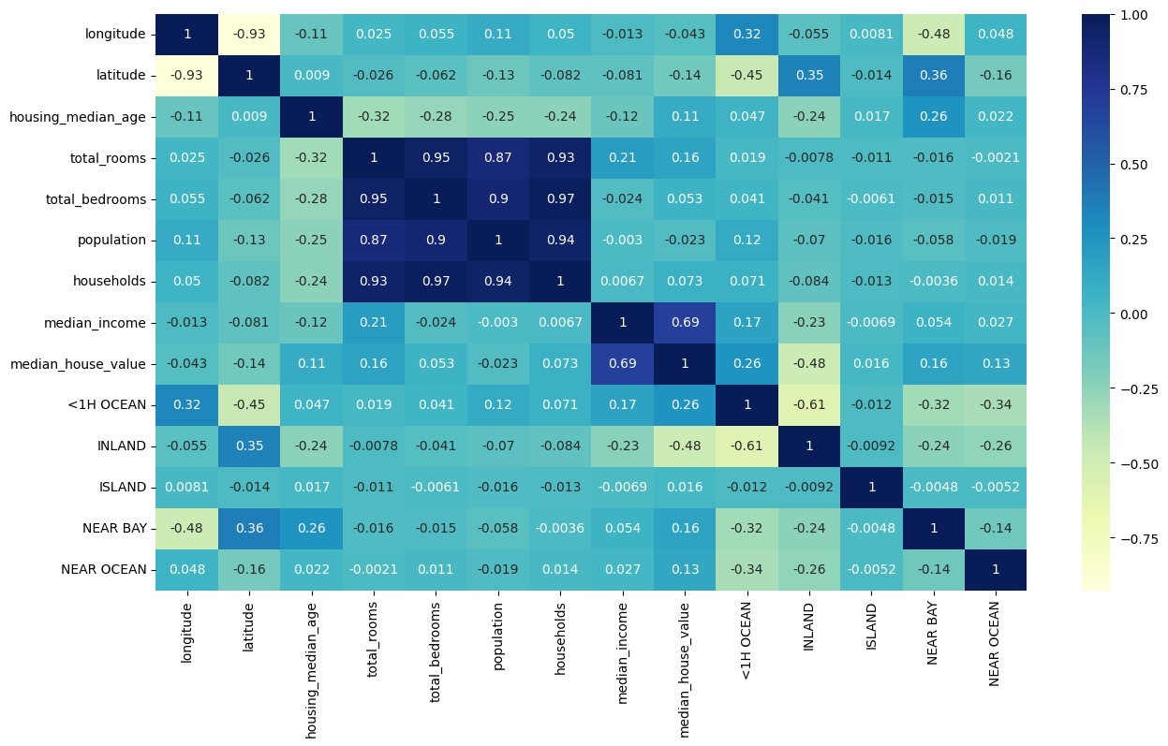

Slide 11
I also used a scatter plot to visualize the median house value against longitude and latitude.
In the graph we can see that house near the ocean have a higher price compared to the other houses.
So the prices of the houses are mostly affected by the location of the house.

Slide 12
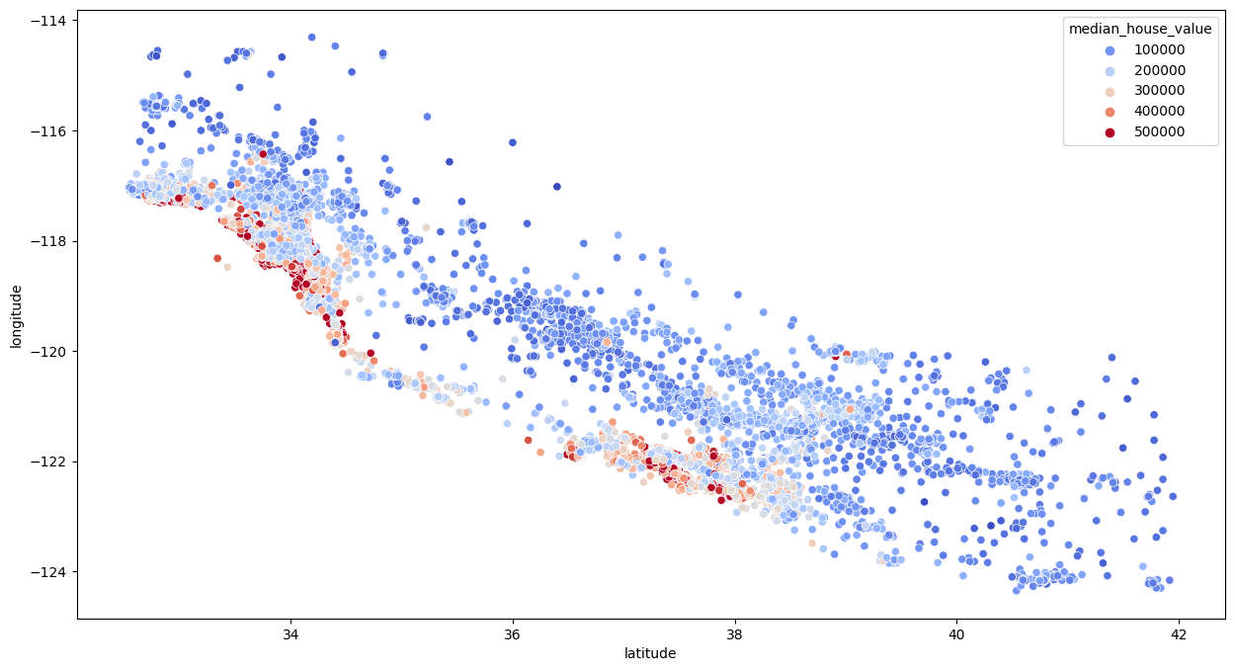

Slide 13
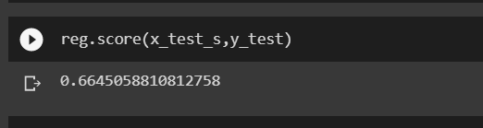
MODEL SELECTION AND EVALUATION
In this project, I used various machine learning models used for the analysis, such as linear regression and random forest regression.
Linear regression is a regression model that estimates the relationship between one independent variable and one dependent variable. When I used linear regression the prediction accuracy scale is 66%.

Slide 14
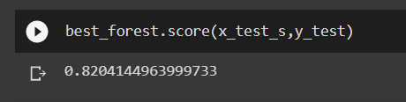
Random forest regression prediction accuracy was 82%
In the end we found out that random forest regression was the best in this project since it predicted the house prices at a higher percentage compared to linear regression.
The accuracy of 82% really helps the sellers and real estate investors to market their houses easier since there will be less price reductions and faster sales of the houses.

Slide 15
CONCLUSION
In conclusion, house prices prediction is a very important tool to both buyers and sellers which helps them make informed decisions.
Accurate prediction is really helpful since it provides important insights about the house markets enabling home buyers, investors and real estate agents to make informed decisions that helps them to go with house market trends and helps them to manage the houses.

